Slide 1
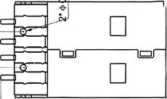
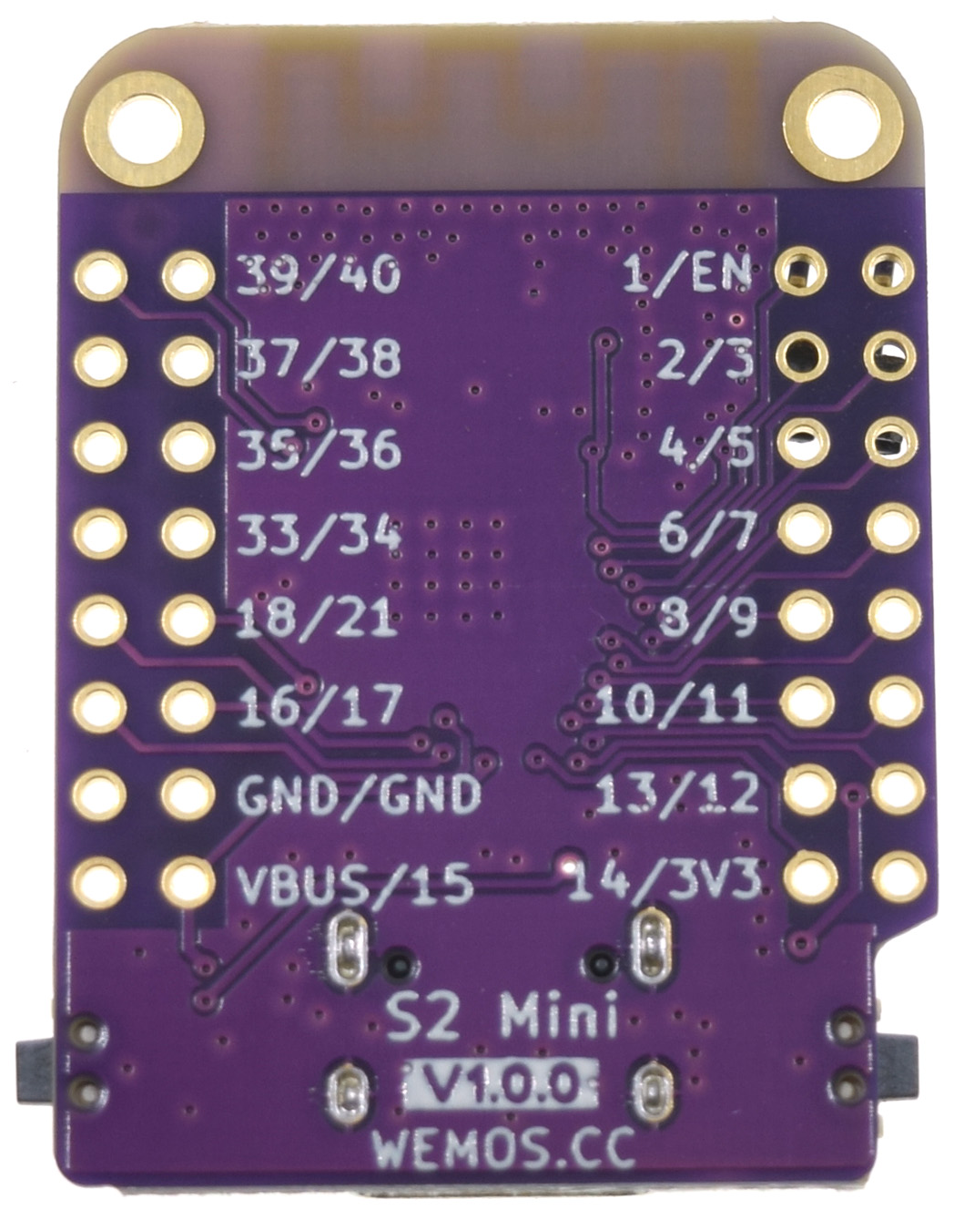
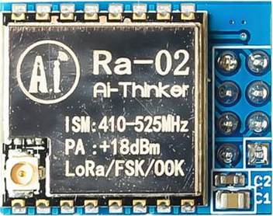
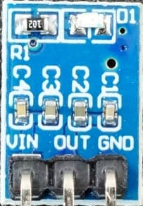
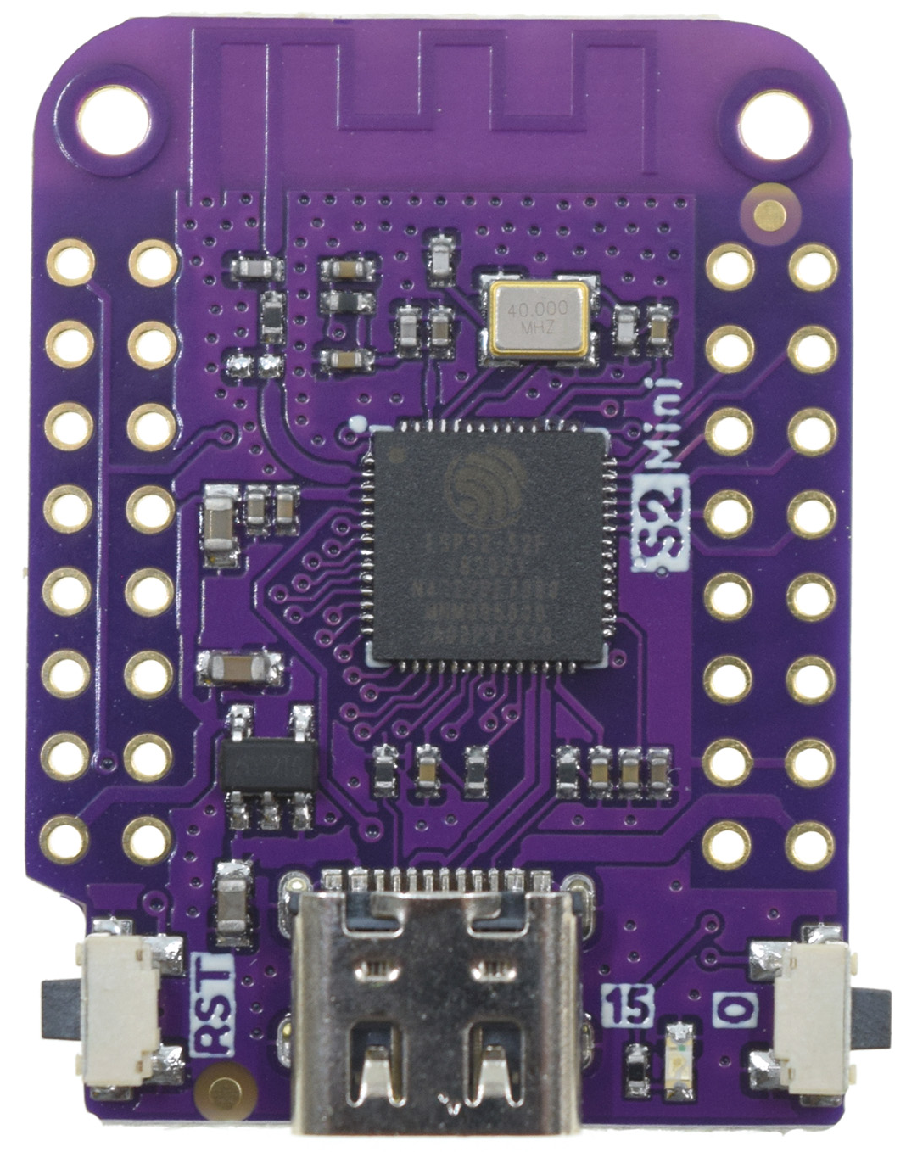
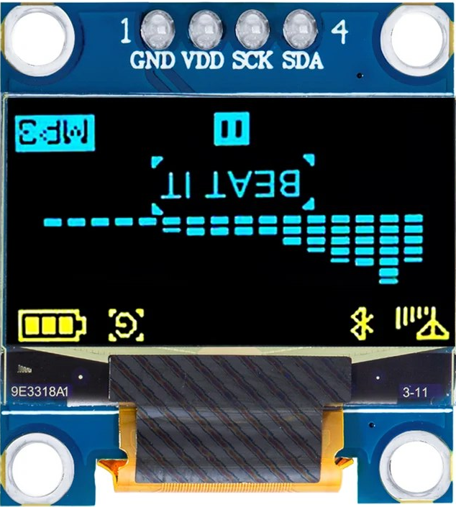
LoRa2MQTT
GND
RST
SCK
MISO
3V3
NSS
MOSI
INT
#define LORA_RST 39
#define LORA_SCK 37
#define LORA_MISO 35
#define LORA_SS 33
#define LORA_MOSI 18
#define LORA_INT 16
#define I2C_SCL 3
#define I2C_SDA 5
#define PIN_LED 15

Slide 2
CellLoRa
Buck module: remove pins, solder only 5V pin. Place on PCB, fold 5V pin toward C and solder there
Red wire upside through W and I, fold toward V and J respectively
Solder Boost. Fold pins Vo-H, GND-N and Vi-E
Red wire runs underside from H to J-I
Boost Vo over module red wire to R pass-through
Solder 10K underside through S and back through O. A dangles
Prepare C3:
Solder all pins except G, T, A
Yellow core pins point up (incl. O), soldered underside. Violet pins must have enough length underside to solder to PCB for support
Remove bottom spacers. Keep upper spacers
Place C3, fold pins V-W and solder all including upper-pointing pins
Solder 10K’s A leg up to C3. Ensure S-O is linked between PCB and C3
Braid together 1 strand each of black and wrapper wires, solder through T from underside up to C3
Solder 100K topside, through B and A (castillation)
Solder transistor underside at D, G (up to C3), S
Place AHT10 on PCB and insert 4-pin header from underneath. Solder from upside, then remove spacers. Wrap wires underside with C3.
Solder battery wires from B and T underside peeking up and toward connector legs (L, M). Blue wire to Boost Vi underside via B.
Place battery connector, fold pins and solder.
Black wire from M to N is topside, at N fold toward O-S and solder
Relay: clip NC pin and solder underside C, R, I, D
Glue-gun Relay to PCB
Populate LoRa pins except VCC and GND. DIO is NC. Yellow core pins point up, so headers are inserted from above and soldered underside
LoRa VCC and GND are pass-through from underside to Buck module
Wrap SPI wires topside between LoRa and C3
D must be pulled up at 5V
Buck
C
R
I
D
W
V
H
J
T
Boost
N
O
S
G
E
10K
A
B
100K
M
L
#define LORA_POWER 4
#define LORA_MOSI 2 // LED (pull-up)
#define LORA_SS 10
#define LORA_MISO 5
#define LORA_SCK 6
#define LORA_RST 7
#define I2C_SCL 3
#define I2C_SDA 1
#define PIN_ADC 0
#define PIN_UNUSED 8 // Strapping (up)
#define PIN_BOOT 9 // S
trapping (float)

Slide 3
CellLoRa noRelay
Buck
Boost
#define UART_TX 21
#define UART_RX 2 // strapping pull-up
#define PIN_ADC 3
#define I2C_SDA 0
#define I2C_SCL 1
#define I2C_AHT10 0x38
#define LORA_POWER 4
#define LORA_MOSI 10
#define LORA_SS 20
#define LORA_MISO 5
#define LORA_SCK 6
#define LORA_RST 7
#define LORA_INT -1
50K
G
A
G
D
S
10K
A
100K
A

Slide 4
BalLoRa
Buck module: remove pins, solder only 5V pin, remove spacer. Place on PCB, fold 5V pin toward C and solder
Red wire upside through W and I, fold toward V and J respectively
Solder boost module
Boost Vo underside red wire to I-J
Boost Vo upside red wire to R pass-through
Braid together 1 strand each of black and wrapper wires, solder through X from underside then back through Y point toward T
Prepare C3:
Solder all pins except G and A
Yellow core pins point up, soldered underside. Violet I/O pins should have enough length underside to solder to PCB
Remove upper spacers, Keep lower spacers
Solder black wire topside at T and dangles
Place C3, fold V and T pins, solder all. Ensure V-W and Y-T are connected
Dangling black wire from T crosses under C3, through PCB at S and soldered to C3 S pin.
Solder 100K underside, through B and A (up to C3)
Solder transistor underside at D, G (up to C3), S. Ensure everything is connected at S (C3 pin, black wire from T, TR sink)
Solder 10K underside with solder at K (with 100K) and O (with TR)
Layer insulation tape over TR and resistors
Place and solder 4P connector. Wrap/solder wires underside
Place battery connector, fold pins for easier soldering. Solder wires underside. Blue wire to Boost Vi underside through to B
Relay: clip NC pin and solder underside C, R, I, D
Glue-gun Relay to PCB
Populate LoRa pins except 3, 2. Yellow core pins point up. Solder on PCB
LoRa 2, 3 are long pass-through underside to Buck module
Solder SPI wrapping wires topside
C
R
I
D
W
V
J
Y
T
X
G
S
2
1
O
10K
K
A
3
B
100K

Slide 5
BalLoRa No Relay
Buck module: remove pins, solder only 5V pin, remove spacer. Place on PCB, fold 5V pin toward C and solder
Red wire upside through W and I, fold toward V and J respectively
Solder boost module
Boost Vo underside red wire to I-J
Boost Vo upside red wire to R pass-through
Braid together 1 strand each of black and wrapper wires, solder through X from underside then back through Y point toward T
Prepare C3:
Solder all pins except G and A
Yellow core pins point up, soldered underside. Violet I/O pins should have enough length underside to solder to PCB
Remove upper spacers, Keep lower spacers
Solder black wire topside at T and dangles
Place C3, fold V and T pins, solder all. Ensure V-W and Y-T are connected
Dangling black wire from T crosses under C3, through PCB at S and soldered to C3 S pin.
Solder 100K underside, through B and A (up to C3)
Solder transistor underside at D, G (up to C3), S. Ensure everything is connected at S (C3 pin, black wire from T, TR sink)
Solder 10K underside with solder at K (with 100K) and O (with TR)
Layer insulation tape over TR and resistors
Place and solder 4P connector. Wrap/solder wires underside
Place battery connector, fold pins for easier soldering. Solder wires underside. Blue wire to Boost Vi underside through to B
Relay: clip NC pin and solder underside C, R, I, D
Glue-gun Relay to PCB
Populate LoRa pins except 3, 2. Yellow core pins point up. Solder on PCB
LoRa 2, 3 are long pass-through underside to Buck module
Solder SPI wrapping wires topside
C
R
I
D
W
V
J
Y
T
X
G
S
2
1
O
10K
K
A
3
B
100K

